Slide 1
Welcome to the world of 8051 Programming Aspects – Session – 1
Shriram K Vasudevan
YouTube Channel: https://www.youtube.com/user/master4hereever
(You can search as Shriram Vasudevan as well)

Slide 2
Agenda
Instruction Set – An introduction
Addressing Modes
Arithmetic Instructions
Logical Instructions
Data Transfer Instructions
Boolean Instructions
Branching Instructions
Know these – Signed/Unsigned
Know these – Packed/Unpacked

Slide 3
Instruction Set
8051 has got lot of instructions with which the programming can done and targets can be achieved.
An Instruction is basically a combination of two parts one is operation code and the next is operands.
Operation code is also called as opcode.
Operands can be one or two based on the instruction.
The opcode will be used to identify on what kind of operation needs to be performed like, addition or subtraction or data movement and so on.

Slide 4
Contd.,
An operand can be any of the following
Registers (like Accumulator, B register and so on)
Immediate value (Say 10H, 010101B)
An address, i.e. memory location. (Say 30H)
Any of the supported input or output ports.
The CPU can fetch information and access data in multiple ways.
As mentioned above the operands will be vital and can be used to fetch information and process it.
Let us learn addressing modes!

Slide 5
Addressing Modes
Instructions can be used with the operands in many ways and the way they are used is referred to be as addressing modes.
There are a set of addressing modes followed in 8051.
Register addressing
Direct addressing
Indirect addressing
Immediate addressing
Relative addressing
Absolute addressing
Indexed addressing and
Long addressing

Slide 6
Contd.,
Register addressing mode | It uses registers as the operands and involves in the information movement between the registers. | MOV A, B - used to transfer content from B to A. MOV A, R0 – used to move the content of R0 to Accumulator A. But programmer must make sure the register bank is selected properly with PSW.

Slide 7
Contd.,
Direct addressing mode | In this mode one of the operands will be the address itself where the information is available. The operands can be memory location like 30H or ports like P2. | MOV A, 030H – Will move the contents of RAM location 30H to the accumulator. MOV A, P2 – Will now transfer the contents of port 2 to accumulator.
Indirect addressing mode | R0, R1 and DPTR are the registers used in this mode. This mode deploys a pointer to hold the address of the pointer. In the previous mode, address was specified right away, but here the place where the address is available will be specified. | MOV @R1, A - Move the content of accumulator to the address pointed by R1.It can be any address as 30H. MOV A,@DPTR – Similar operation. Move the content at location pointed out by DPTR to Accumulator.

Slide 8
Contd.,
Immediate addressing mode | Simplest mode, where the instruction itself will have the information to be moved or to be processed. Instead of storing it in some registers and then moving it to accumulator or processing it, it is easier this way. | MOV A, #10H – Hex value 10 is moved to A. Where # is an indication to the controller that anything followed by # is not address but data. MOV A, #10101011B – Similarly binary data can also be moved. MOV DPTR, #0FFFEH – Here DPTR is a 16 bit register so moving 16 bit data to it. Note: Source data and Destination register should be of same size.

Slide 9
Contd.,
Relative addressing mode | When instructions as SJMP or JNZ are used it is referred to be as Relative addressing mode. This mode helps transfer of control from one piece of code to other. Say subroutine execution, once executed the control will be moved to the place from where it started. | HERE: DJNZ R1, HERE – R1 is decremented and until it is 0 it will be doing this once done the control will be transferred to next part. LOOP: JNB TF1, LOOP // until roll over, keep doing.
Absolute addressing mode | In Absolute Addressing mode, the absolute address, to which the control is transferred, is Specified by a label. Two instructions associated with this mode of addressing are ACALL and AJMP instructions. These are 2-byte instructions. | ACALL GO_THERE GO_THERE: MOV A,#10H; The above instruction stands as support for Absolute addressing mode.

Slide 10
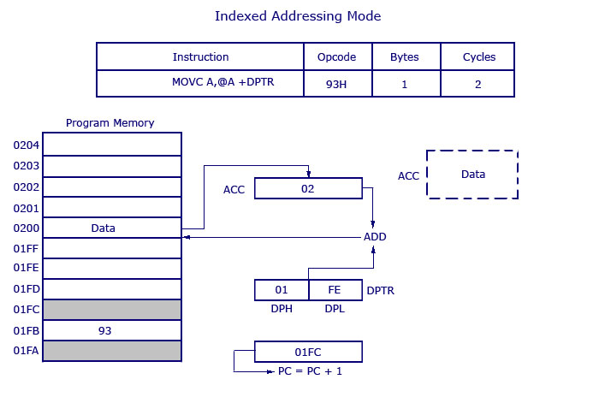
Contd.,
Indexed addressing mode | The Indexed addressing is useful when there is a need to retrieve data from a look-up table. A 16-bit register (data pointer) holds the base address and the accumulator holds an 8-bit displacement or index value. The sum of these two registers forms the effective address for a JMP or MOVC instruction | MOV A,#099H ;Offset from table start MOV DPTR,#01E00H ;Table start address MOVC A, @A+DPTR; Gets target value from the table. start address + offset is calculated and put in A.
DPTR holds the value 01FE, where 01 is located in DPH (higher 8 bits) and FE is located in DPL (lower 8 bits). Accumulator now has the value 02H. A 16 bit addition is performed and now 01FE H+02 H results in 0200 H. What ever data is in 0200 H will get transferred to accumulator.

Slide 11
Contd.,
Long addressing mode | When the instructions use LCALL or LJMP it is referred to be as Long addressing mode. | LCALL TIMER_ROUTINE TIMER_ROUTINE: MOV TMOD, #10H Above instructions are the example for Long addressing mode.
The instruction set can be broadly classified into five types:
Arithmetic instructions
Logical instructions
Data transfer instructions
Boolean variable instructions
Program branching instructions

Slide 12
Welcome to the world of 8051 Programming Aspects – Session – 2
Shriram K Vasudevan

Slide 13
Agenda
Instruction Set – An introduction
Addressing Modes
Arithmetic Instructions
Logical Instructions
Data Transfer Instructions
Boolean Instructions
Branching Instructions
Know these – Signed/Unsigned
Know these – Packed/Unpacked

Slide 14
Arithmetic Instructions
These are the set of instructions that can perform all arithmetic operations as addition, subtraction, multiplication and division.
One thing to be remembered is, 8051 has no special knowledge on if the data is signed or unsigned.
So, programmer must pay some care for the same. And the appropriate status bits are set in PSW (Program Status Word) after the arithmetic operation is complete. .

Slide 15
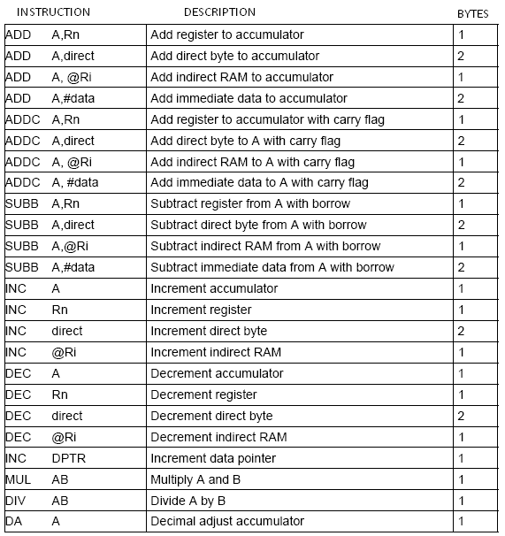
Tail piece: Arithmetic instructions affect Carry flag (CY) and Overflow flag (OV) in the PSW.

Slide 16
Instruction wise description – Arithmetic instructions
ADD
As the name indicates it is used to perform addition operation.
Syntax: ADD A, source byte
After addition the result will be moved to the accumulator. Based on the result of the operations the CY, Auxiliary carry and Parity flags will be set accordingly and can be seen from PSW.
An example would serve the purpose here.
MOV A, #01 H
ADD A, #0C H
The result would be A=0DH; CY=0;

Slide 17
Contd., Addressing Modes Supported for ADD instruction.
Mode | Instruction and description
Immediate addressing | Example has been shown just above.
Register addressing | ADD A,Rn Example: MOV A,#01H MOV R3,#02H ADD A, R3
Direct addressing | ADD A,Direct_address Example: ADD A, 25H; (this will add the data in RAM location 25H with data available in accumulator and retain the result in accumulator itself)
Register indirect addressing | ADD A,@Ri Example: ADD A,@R1 (this will add the data in to which R0 points to with data available in accumulator and retain the result in accumulator itself)

Slide 18
Exercise Problems
Find the status of the flags CY, AC and P after the addition of 35H with E2H.
Find the value of CY flag after the addition of 53H with 85H.

Slide 19
ADDC
ADDC adds the data byte specified by the source operand, the carry flag and the accumulator contents, having the result left in the accumulator. This will also affect the CY, P and OV flags.
Note:
CY will be set when there is carry out of D7.
AC will be set when there is a carry out of D3
OV will be set when there is a carry out of D7 and not out of D6 and vice versa.

Slide 20
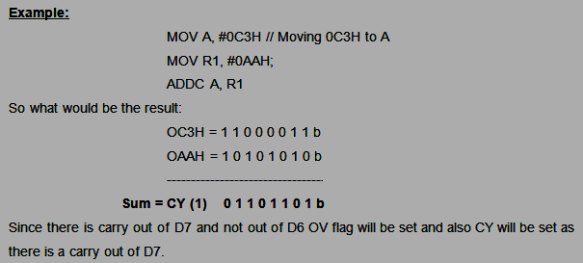
Contd.,
All the modes of addressing supported for ADD will be supported for ADDC as well.

Slide 21
SUBB
SUBB subtracts the specified data byte and the carry flag together from the accumulator, subsequently the result will be kept in the accumulator.
Following things to be remembered with SUBB as well:
CY=1 If a borrow is needed for bit 7; cleared otherwise
AC =1 If a borrow is needed for bit 3, cleared otherwise
OV=1 If a borrow is needed into bit 6, but not into bit 7, or into bit 7, but not into bit 6.

Slide 22
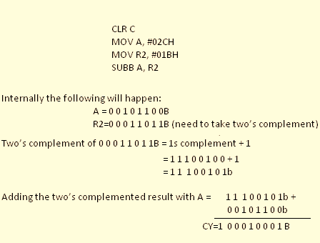
Contd.,
Steps performed by the controller:
1. Take two's complement of the src-byte. 2. Add this to register A. 3. Invert the carry.
And if the carry is 0, then the result is positive and nothing more needs to be done. If carry is 1, result is negative and 2s complement of the result has to be taken.
Inverting the carry CY=0 and result is 00010001B and will be stored in accumulator.
Status of flags: CY = 0

Slide 23
INC
Increments the data variable by 1. It can be used in addressing modes as follows with
1. Accumulator: INC A
2. Register: INC Rn
3. Direct: INC direct
4. Register-indirect: INC @Ri
If the value is FF and it is incremented it will roll over to 00H.
Example usage:
INC A; // Increment accumulator
INC 56H; // increment value at 56H
INC R1; // Increment value in R1.

Slide 24
DEC and DPTR
DEC
Decrements the data variable by 1. The instruction is used in accumulator, register, direct or register direct addressing modes as above. No flags will be affected.
INC DPTR
Increments the 16-bit data pointer by 1. DPTR is the only 16-bit register that can be incremented. The instruction adds one to the contents of DPTR directly.

Slide 25
MUL AB
MUL AB multiplies the unsigned eight-bit integers stored in the accumulator and register B. Only A and B can be used for the multiplication operation and once the 16 bit result is obtained, the lower order byte will be left in accumulator and higher order byte is moved to B. B plays role in Multiplication and Division and it is proven here. If the result is greater than 255 (0FFH) the overflow flag is set; else it is cleared. The carry flag is always cleared.
Example: MOV A, #4
MOV B, #5
MUL AB
Result: 20 (in decimal). Hex equivalent: 14H.
A = 14H, B=00H and CY =0

Slide 26
DIV AB
DIV AB divides the unsigned eight-bit integer in the accumulator by the unsigned eight-bit integer in register B.
B plays role in Multiplication and Division and it is proven here.
The accumulator receives the quotient which is an integer and register B receives the remainder which is again an integer. The carry and OV flags will be cleared.
Example: MOV A, #60; 3C H
MOV B, #5; 05 H
MUL AB
Result: 60/2 is 12, i.e. OC will be moved to A and 00 will be moved to B
A = OCH, B=00H and CY =0

Slide 27
DA A
This is a decimal adjust instruction.
It does the adjustment of the 8-bit value in A resulting from ADD or ADDC and produces two 4-bit digits (in packed Binary Coded Decimal (BCD) format).
Precisely, the decimal conversion is performed by adding 00H, 06H, 60H or 66H to the accumulator, based on the initial value of ACC and PSW

Slide 28
Welcome to the world of 8051 Programming Aspects – Session – 3
Shriram K Vasudevan

Slide 29
Agenda
Instruction Set – An introduction
Addressing Modes
Arithmetic Instructions
Logical Instructions
Data Transfer Instructions
Boolean Instructions
Branching Instructions
Know these – Signed/Unsigned
Know these – Packed/Unpacked

Slide 30
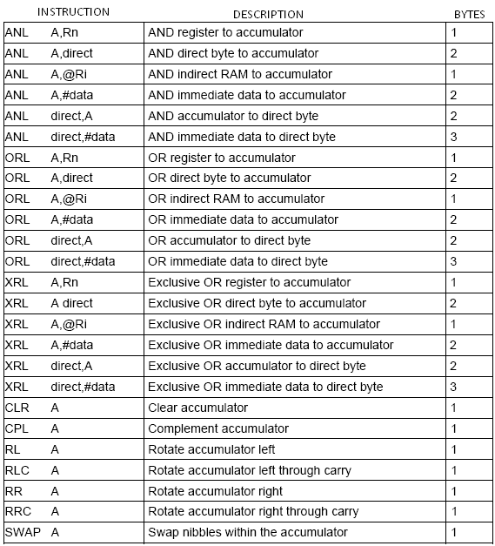
Logical Instructions
All logical operations as AND, OR, NOT, XOR can be performed with these available instructions. All operations are done bit wise.
The other operations which come under logical quota are swap, clearing accumulator and rotate operations.

Slide 31
ANL
ANL Dest, Source
Bitwise logical ANDing will be performed with this instruction between source and destination and the result is stored in the destination. No flags will get affected here in this instruction.
Example: ANL A, R2
If ACC=D3H (11010011) and R2=75H (01110101), then the result would be51H (01010001) and would be stored in the accumulator.

Slide 32
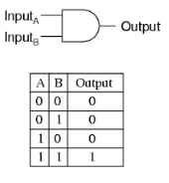
ANL Contd.,
Mode | Instruction and description
Immediate addressing | ANL A, #data Example: ANL A,#01H
Register addressing | ANL A, Rn Example: ANL A, R3
Direct addressing | ANL A, Direct Address Example: ANL A. 25H; // AND with data at 25H
Register indirect addressing | ANL A,@Ri Example: ANL A,@R0 // AND with data pointed by Register R0.
ANL Direct, A | Just reverse of Directing addressing way
ANL Direct, #data | ANDing immediate data with the direct addressing. Example: ANL 30H, #03H

Slide 33
ORL
ORL Dest, Source
Bitwise logical ORing will be performed with this instruction between source and destination and the result is stored in the destination.
No flags will get affected here in this instruction.
Example: ORL A, R2
If ACC=D3H (11010011) OR R2=75H (01110101), the result F7H (11110111) will be stored in the accumulator.

Slide 34
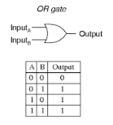
ORL Contd.,
Mode | Instruction and description
Immediate addressing | ORL A, #data Example: ORL A,#01H
Register addressing | ORL A, Rn Example: ORL A, R3
Direct addressing | ORL A, Direct Address Example: ORL A. 25H; // ORL with data at 25H
Register indirect addressing | ORL A,@Ri Example: ORL A,@R0 // Logical-OR with data pointed by Register R0.
ANL Direct, A | Just reverse of Directing addressing way
ANL Direct, #data | ORing immediate data with the direct addressing. Example: ORL 30H, #03H

Slide 35
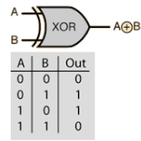
XRL
Bitwise logical XORing will be performed with this instruction between source and destination and the result is stored in the destination. No flags will get affected here in this instruction.
Example: XRL A, R2
If ACC=08H (00001000) OR R2=18H (00011000), the result 10H (00010000) will be stored in the accumulator.

Slide 36
XRM Contd.,
Mode | Instruction and description
Immediate addressing | XRL A, #data Example: XRL A,#01H
Register addressing | XRL A, Rn Example: XRL A, R3
Direct addressing | XRL A, Direct Address Example: XRL A. 25H; // ORL with data at 25H
Register indirect addressing | XRL A,@Ri Example: XRL A,@R0 // XOR with data pointed by Register R0.
ANL Direct, A | Just reverse of Directing addressing way
ANL Direct, #data | XORing immediate data with the direct addressing. Example: XRL 30H, #03H

Slide 37
CLR A / CPL A
CLR A
The indicated be reset to zero. Here the accumulator is set to reset. No flags are affected due to this instruction.
CPL A
Will complement the content of the accumulator, bit wise. Each bit will be complemented. I.e. if 0, complemented as 1 and if 1 complemented as 0. No flags are affected.
Example: MOV A. #00H
CPL A
Result will be FFH and is stored in the accumulator.

Slide 38
RL and RLC
RL A
The eight bits in the accumulator 1ill be rotated one bit to the left. Bit 7 is rotated and moved to bit 0 position. An example would be handy here. No flags are affected
Example: MOV A, #10H
RL A;
Result would be: 20H and would be stored in the accumulator.
RLC A
The instruction rotates the accumulator contents one bit to the left through the carry flag. Bit 7 of the accumulator will move into carry flag and the original value of the carry flag will move into the Bit 0 position. No other flags will be affected.
Example:
If ACC=C3H (11000011), and the carry flag is 1, the instruction results in ACC=87H (10000111) with the carry flag set

Slide 39
RR A
RR A
The eight bits in the accumulator will be rotated one bit to the right. Bit 0 is rotated and moved to bit 7 position. No flags are affected
Example: MOV A, #10H
RR A;
Result would be: 08H and would be stored in the accumulator.

Slide 40
SWAP
SWAP A
Swap nibbles for the value stored within the accumulator. No flags will be affected due to this instruction.
Example: MOV A, #32H
SWAP A
Now Accumulator will have 23H stored.
Do it yourself - RRC A

Slide 41
Welcome to the world of 8051 Programming Aspects – Session – 4
Shriram K Vasudevan

Slide 42
Agenda
Instruction Set – An introduction
Addressing Modes
Arithmetic Instructions
Logical Instructions
Data Transfer Instructions
Boolean Instructions
Branching Instructions
Know these – Signed/Unsigned
Know these – Packed/Unpacked

Slide 43
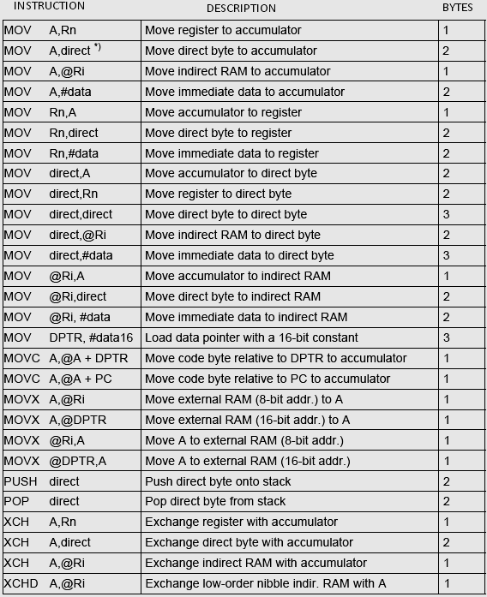
Data Transfer Instructions
It is used to transfer data from one register to another or from memory locations.
Direct and indirect addressing methods can be used for data transfer to be achieved.

Slide 44
Instruction wise learning …
MOV Dest, Source
This instruction moves the source data to the destination specified and no flags will be affected because of this. The source data will be remaining the same because of this operation. The following are the possible combinations of MOV instruction.
Examples:
MOV R1, #87H; // Moving some data to R1.
MOV A, @R1; // Transferring it to Accumulator.
MOV R1, #62H; // Getting data to R1.
ADD A, @R1; A=A+62H // Adding both the data.
MOV R3, A; R3=Result. // Store the result in different register

Slide 45
Contd.,
Note that, only the destination register is altered.
Following are the ways the MOV instruction can be used:
With A as the destination.
Example: 1. MOV A, #01H, 2. MOV A.30H
With A as source
Example: 1. MOV R1, A, 2. MOV @R1, A
With Rn as the destination
Example: 1. MOV R1, A 2. MOV R3, #45H
With Rn as source
Example: MOV A, R1
With an indirect address
Example: 1. MOV @R1, A 2. MOV @R0, #90H
With destination as Direct address
Example:
1. MOV 50H, A
2.MOV 50H, #67H
3. MOV 50H @R1
4. MOV 50H, R1

Slide 46
More Move!
MOV DPTR, #16bit_data
This instruction loads the data pointer with the 16-bit constant and no flags are affected.
Example: MOV DPTR, #1EFAH; this will now load DPH with 1EH and DPL with FAH.
MOVC A, A+@DPTR and MOVC A, A+@PC
MOVC instructions load the accumulator with a code byte, or constant from program memory. The address of the byte fetched is the sum of the original unsigned eight-bit accumulator contents and the contents of a sixteen-bit base register, which may be either the data pointer or the Program Counter register.
Example:
MOVC A, @A + DPTR; move data at A+DPTR into A
MOVC A, @A + PC; move data at A+PC into A

Slide 47
Contd.,
MOVX A,@Ri
This will move to the accumulator a byte from the external memory being pointed by Ri, where Ri needs to be R0 or R1.
MOVX A, @DPTR
DPTR here points to the external memory and a byte from that address will be moved to accumulator. X in the instruction is representing external memory.
MOVX @Ri, A
This will move from the accumulator a byte to the external memory being pointed by Ri, where Ri needs to be R0 or R1.
MOVX @DPTR, A
This will move the accumulator content to the external memory location, which is pointed by DPTR.

Slide 48
PUSH and X Change!
PUSH and POP
Very useful instructions which are use to PUSH data onto the stack and to POP data out of it as well. Enough and easier examples are given in the stack programming area. Reader can refer them for knowing the usage of PUSH and POP better.
Exchange instruction
By its very name one can understand. It is used to exchange the content.
Example:
XCH A, R1; Used to exchange the content from R1 to A and A to R1.
XCH A, 30H; Direct addressing mode, where content at 30H is exchanged with A.
XCH A, @R1; R1’s content is exchanged with Accumulator.

Slide 49
Welcome to the world of 8051 Programming Aspects – Session – 4
Shriram K Vasudevan

Slide 50
Agenda
Instruction Set – An introduction
Addressing Modes
Arithmetic Instructions
Logical Instructions
Data Transfer Instructions
Boolean Instructions
Branching Instructions
Know these – Signed/Unsigned
Know these – Packed/Unpacked

Slide 51
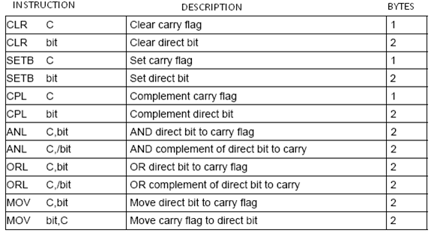
Summary of Boolean…

Slide 52
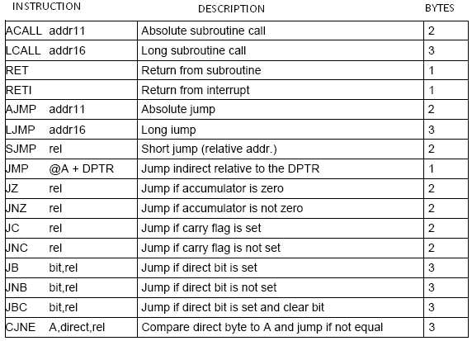
Branching Instructions
Play a vital role and they control the flow of program execution.

Slide 53
Contd.,
ACALL ➔ Used to call subroutine indicated by the address.
PC will be increased by 2, then it pushes the 16-bit PC value onto the stack (low order byte first) and increments the stack pointer twice.
The PC is now loaded with the value addr and the program execution continues from this new location. No flags will be affected.
Example: ACALL SUBROUTINE

Slide 54
Contd.,
LCALL ➔ Calls subroutine located at the indicated address.
The operation will cause the PC to increase by 3, then it pushes the 16-bit PC value onto the stack (low order byte first) and increments the stack pointer twice.
The PC is then loaded with the value addr16 and the program execution continues from this new location.
As it is a Long call, the subroutine may therefore begin anywhere in the full 64 kB program memory address space. No flags are affected.
Example: LCALL SUBROUTINE

Slide 55
Contd.,
RET ➔ Return from a subroutine can be performed with RET. RET pops the high and low-order bytes of the PC from the stack, decrementing the stack pointer by two. Can be used with ACALL and LCALL to return after the subroutine is executed.
RETI ➔Return from the interrupt can be done with RETI. As RET, RETI also pops the high and low-order bytes of the PC from the stack, decrementing the stack pointer by two.
AJMP ➔ Program execution will be transferred to the destination address which is located at the absolute short range distance. The destination must be within the same 2 KB block of program memory for this JMP to be accomplished. No flag will be impacted.
Example: AJMP HERE

Slide 56
Contd.,
LJMP ➔ Transfers program execution to the destination address which is located at the absolute long range distance (long range means 16-bit address). And hence the destination may be anywhere in the full 64 kB program memory address space. No flags are affected.
Example: LJMP HERE
SJMP ➔ Short jump instruction, increments the PC by 2 and adds the relative value ‘rel’ (signed 8-bit) to the PC. This will be the new address where the program would branch to unconditionally So, the range of destination allowed is from -128 to +127 bytes from the instruction
Example: SJMP REL_JUMP

Slide 57
Contd.,
JZ ➔ This instruction branches to the destination address if ACC=0;
Example: JZ Here
MOV A, # 01H
Here: MOV A, #08H
Above code will check if ACC =0, if yes it will move to Here as shown in the code. If non zero, it will execute the next line.

Slide 58
Contd.,
JNZ ➔ It is just opposite to the above instruction. It will jump if Accumulator has got non zero values. Means if any of the bit in accumulator is set, it will branch.
Example: JNZ Here
MOV A, # 01H
Here: MOV A, #08H
Above code will check if ACC =1 or Non zero values, if yes it will move to Here as shown in the code. If not, it will execute the next line.

Slide 59
Contd.,
JC ➔ If the carry flag is set, branch to the target address indicated; else move with the next instruction.
Example: JC GO_THERE
JNC ➔ If the carry flag is a zero, branch to the target address; else navigate to the next instruction
Example: JNC GO_THERE

Slide 60
Contd.,
JB ➔ If the indicated bit is a one, jump to the target address indicated; otherwise proceed with the next instruction.
Example:
SETB P1.3 ; Make P1.3 an input port HERE: JB P1.3, HERE ; Be here as long as P1.3=1 MOV P2, #55H ; if P1.3=0 send 55H to P2
JNB ➔ Just exactly opposite to the above instruction and it is Jump on No Bit set.
JBC ➔ Jump if bit is set and clear bit. If one, jump to the target address and clear the designated bit. The branch destination is computed by adding the signed relative displacement in the third instruction byte to the PC, after incrementing the PC to the first byte of the next instruction.
CJNE ➔ Compare and Jump if not Equal. CJNE compares the first two operands, and branches if their values are not equal.

Slide 61
Welcome to the world of 8051 Programming Aspects – Session – 5
Shriram K Vasudevan

Slide 62
Agenda
Instruction Set – An introduction
Addressing Modes
Arithmetic Instructions
Logical Instructions
Data Transfer Instructions
Boolean Instructions
Branching Instructions
Know these – Signed/Unsigned
Know these – Packed/Unpacked

Slide 63
Signed Vs. Unsigned
Unsigned Representation:
As the name says, this is unsigned. Means there is no bits set aside for indication of positive or negative numbers.
43H to represent in binary: 0100 0011B
The range of the numbers is from 0 to +127.
Unsigned addition
Add these two unsigned numbers 34H and 89H
34H = 0011 0100 B
89H = 1000 1001 B
Result= 1011 1101 B
And in hexadecimal representation it is BDH.

Slide 64
Signed Representation
One bit on the whole is kept aside for indicating the sign i.e. positive or negative.
The D7th bit is set aside for that purpose. If the D7th bit is 1, then it is negative and if not it can be confirmed to be positive.
Assuming a number as -43, then how it will be represented?
Simply follow the steps:
Write the signed number in binary format. Here it is 0100 0011
Take 1s complement. Here it is 1011 1100
Add 1 to it. i.e. two’s complement. 1011 1101. D7 is 1, so it is negative. And the equivalent hex value is BDH.
Overflow flag will be set in the following occasions:
There is a carry from D6 to D7, but no carry out of D7.
There is a carry from D7 out (CY=1), but no carry from D6 to D7.

Slide 65
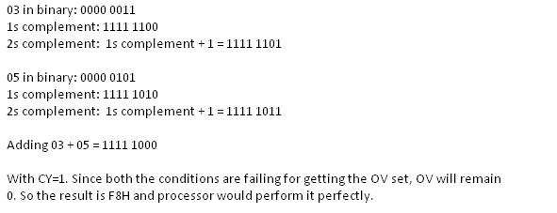
What would be the result if -3 is added with -5. Also indicate the status of OV flag.
OV Will be set!
There is a carry from D6 to D7, but no carry out of D7.
There is a carry from D7 out (CY=1), but no carry from D6 to D7.

Slide 66
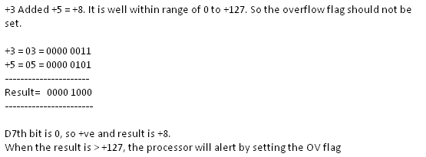
Contd.,
What would be the result if +3 is added with +5. Also indicate the status of OV flag.

Slide 67
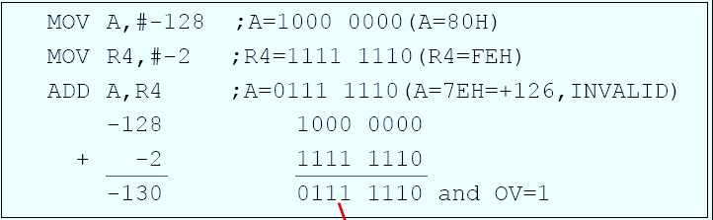
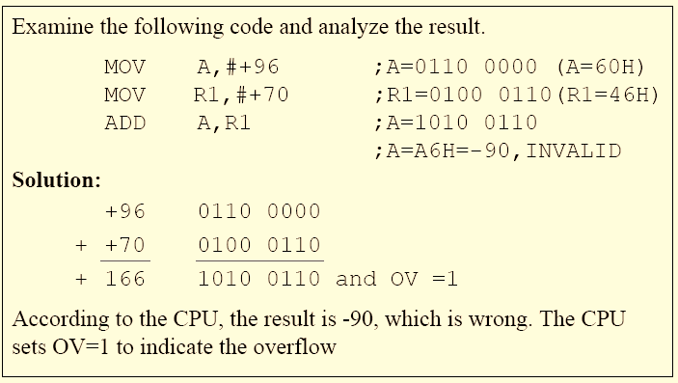
Contd.,

Slide 68
Packed Vs. Unpacked!
When using BCD, (Binary Coded Decimal) format the terms Packed and Unpacked BCD are very much in usage.
What is the difference?
Packed BCD:
If for example 0101 0111 (57) is taken, one can see that both the lower order and higher order bits are BCD numbers. Means they are from 0 -9. This is referred to be as packed BCD.
Unpacked BCD:
The number 75 in packed BCD would be 01110101.
Unpacked BCD is each number is represented by its own byte.
The number 75 in unpacked BCD would be 00000111 and 00000101.

Slide 69
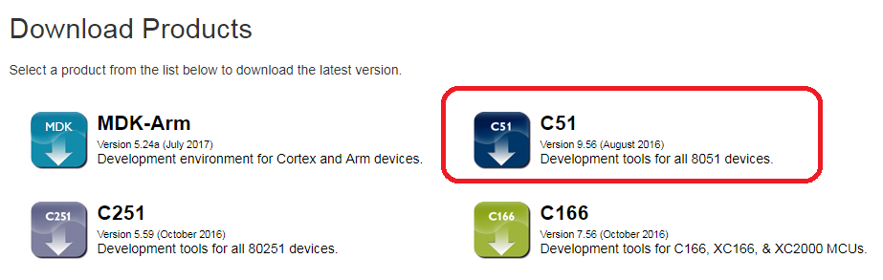
Lets Learn Keil for 8051.
For downloading the evaluation version of KEIL one can visit http://www.keil.com/download/product/ to get the version of KEIL that supports 8051

Slide 70
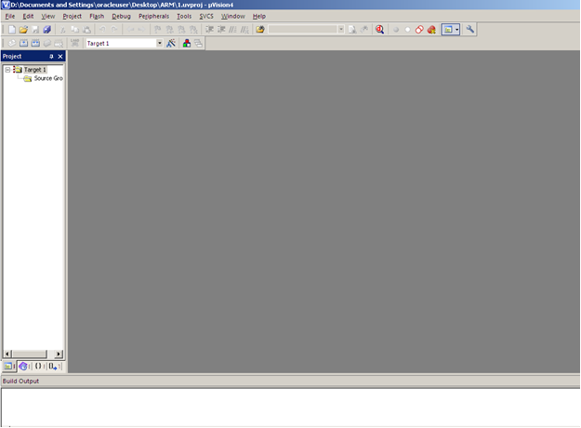
Screen on launch!

Slide 71
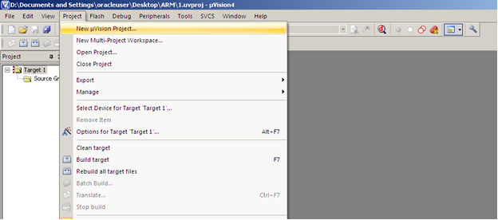
New project selection

Slide 72
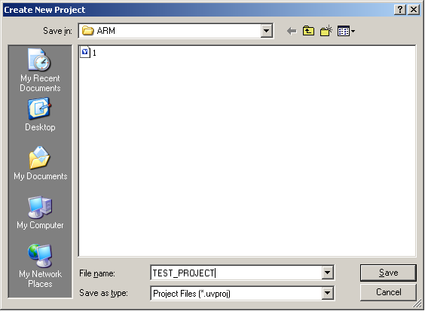
Project Creation

Slide 73
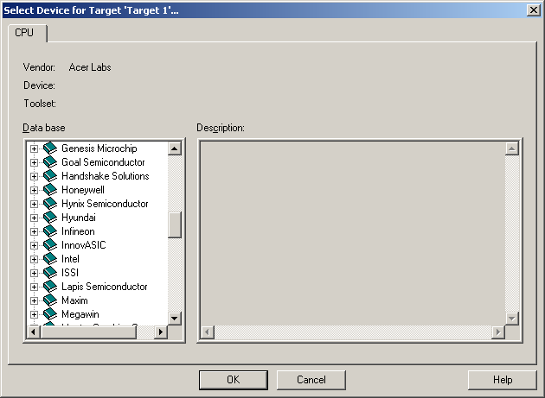
Vendor Selection

Slide 74
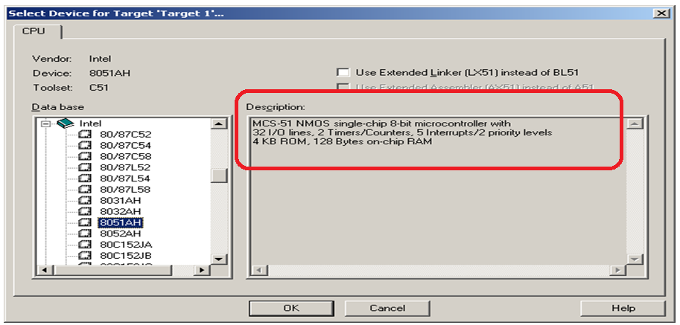
Select Intel 8051 – Controller

Slide 75
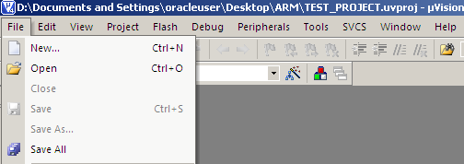
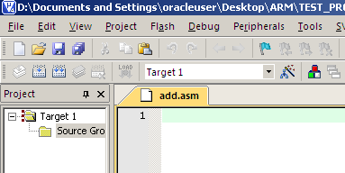
New File Creation (Should be .asm files)

Slide 76
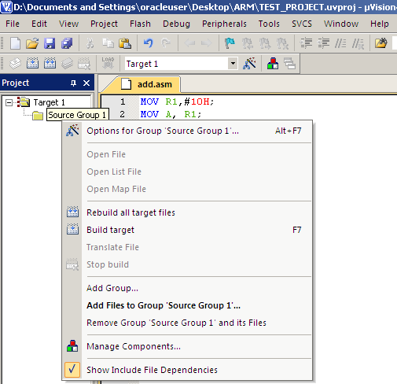
Add Group

Slide 77
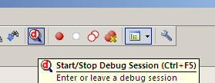
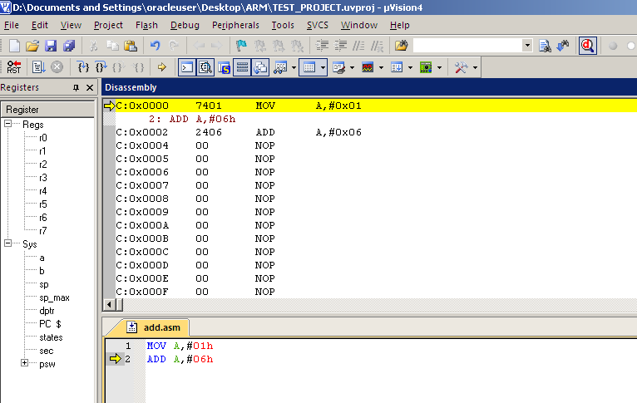
Build and Run!

Slide 78
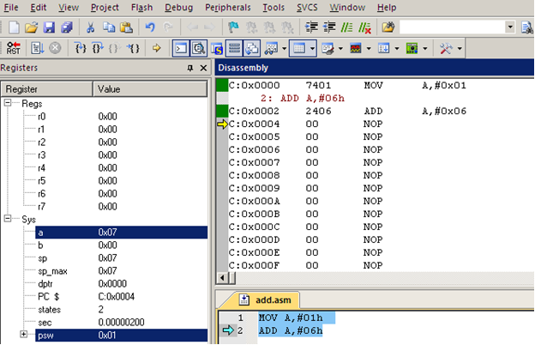
See the status..

Slide 79
Je vous remercie
施拉姆

